Slide 1
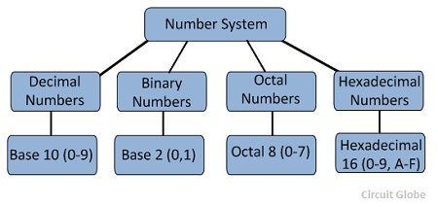

Slide 2
Dec to Hex
(20)dec to (?)hex 8 4 2 1
16 20 128 64 32 16 8 4 2 1 16+4= 20
1 4 0 0 0 1 0 1 0 0 (20)
14(hex) 1 4
164(dec) to (?)hex 1 0 1 0 0 1 0 0 (164) 64+32+4=100
16 164 A 4
10 4 8 4 2 1 8 4 2 1 (hex)
A4(hex) 10 11 12 13 14 15 A B C D E F
1 0 1 0 0 1 0 0 (A4)

Slide 3
(1535)DEC TO (HEX)
8 4 2 1 8 4 2 1 8 4 21
1024 512 256 128 64 32 16 8 4 2 1
1 0 1 1 1 1 1 1 1 1 1
5 F F

Slide 4
Dec to Oct
248(dec) to oct
8 248 128 64 32 16 8 4 2 1
8 31 0 1 1 1 1 1 0 0 0
3 7 123 64 32 16 8 4 2 1
370(oct) 421 421 421
011 111 000
3 7 0

Slide 5
Oct to Dec
8^0 based on digit position…8^1 for next digit
370(oct) to dec
3*8^2 + 7*8^1 + 0*8^0
3*64 + 7*8 + 0
192 + 56
248(dec10) 128 64 32 16 8 4 2 1 421 421 421
1 1 1 1 1 0 0 0(248) 011 111 000(370)

Slide 6
Oct to Hex
345(oct) to (?)hex
3 4 5 10 11 12 13 14 15
4 2 1 4 2 1 4 2 1 A B C D E F
0 1 1 1 0 0 1 0 1
8421 8421
0 1110 0101
E 5

Slide 7
Hex to Dec
16^0 based on digit position…16^1 for next digit
(23E)hex to (?)dec
2*16^2 + 3*16^1 + 14*16^0
2*256 + 48 + 14 2 1 8 4 2 1
512 + 62 = 574(dec) 512 256 128 64 32 16 8 4 2 1
1 0 0 0 1 1 1 1 1 0
2 3 E

Slide 8
Hex to Oct
(AC)hex to (?)oct
A C
8421 8421
1010 1100
421421421
010101100
2 5 4 254(oct) 10 11 12 13 14 15 A B C D E F

Slide 9
Int x = -1;

